Slide 1

William Stallings Computer Organization and Architecture 10th Edition
Notes:
Lecture slides prepared for “Computer Organization and Architecture”, 10/e, by William Stallings, Chapter 13 “Instruction Sets: Addressing Modes and Formats”.

Slide 2
Chapter 8
Memory Management
Notes:
Although seemingly simple in concept, computer memory exhibits perhaps the widest
range of type, technology, organization, performance, and cost of any feature
of a computer system. No single technology is optimal in satisfying the memory
requirements for a computer system. As a consequence, the typical computer
system is equipped with a hierarchy of memory subsystems, some internal to the
system (directly accessible by the processor) and some external (accessible by the
processor via an I/O module).
This chapter and the next focus on internal memory elements, while Chapter 6
is devoted to external memory. To begin, the first section examines key characteristics
of computer memories. The remainder of the chapter examines an essential element
of all modern computer systems: cache memory.

Slide 3
Memory Management
In order to understand memory management and some additional concepts associated with memory, we need to talk about:
The OS (Operating System)
Scheduler
States of a process
We will mention them, however our focus is how memory is treated.
Notes:
The most important system program is the OS.
The OS masks the details of the hardware from the programmer and provides the
programmer with a convenient interface for using the system. It acts as mediator,
making it easier for the programmer and for application programs to access and use
those facilities and services.
Briefly, the OS typically provides services in the following areas:
• Program creation: The OS provides a variety of facilities and services, such
as editors and debuggers, to assist the programmer in creating programs.
Typically, these services are in the form of utility programs that are not actually
part of the OS but are accessible through the OS.
• Program execution: A number of steps need to be performed to execute a
program. Instructions and data must be loaded into main memory, I/O devices
and files must be initialized, and other resources must be prepared. The OS
handles all of this for the user.
• Access to I/O devices: Each I/O device requires its own specific set of instructions
or control signals for operation. The OS takes care of the details so that
the programmer can think in terms of simple reads and writes.
• Controlled access to files: In the case of files, control must include an understanding
of not only the nature of the I/O device (disk drive, tape drive) but
also the file format on the storage medium. Again, the OS worries about the
details. Further, in the case of a system with multiple simultaneous users, the
OS can provide protection mechanisms to control access to the files.
• System access: In the case of a shared or public system, the OS controls access
to the system as a whole and to specific system resources. The access function
must provide protection of resources and data from unauthorized users and
must resolve conflicts for resource contention.
• Error detection and response: A variety of errors can occur while a computer
system is running. These include internal and external hardware errors, such as
a memory error, or a device failure or malfunction; and various software errors,
such as arithmetic overflow, attempt to access forbidden memory location, and
inability of the OS to grant the request of an application. In each case, the OS must
make the response that clears the error condition with the least impact on running
applications. The response may range from ending the program that caused the
error, to retrying the operation, to simply reporting the error to the application.
• Accounting: A good OS collects usage statistics for various resources and
monitor performance parameters such as response time. On any system, this
information is useful in anticipating the need for future enhancements and in
tuning the system to improve performance. On a multiuser system, the information
can be used for billing purposes.

Slide 4
Memory Management
RAM MEMORY MANAGER:
The OS RAM memory manager must perform the following functions
Determine a memory allocation policy for multiple users or multiple tasks (jobs)- or both
Track the status of allocated and unallocated memory in appropriate memory status tables
Implement the allocation policy for users/tasks requesting memory – and update status tables
Deallocate (reclaim) memory when a user/task is terminated – and update memory status tables.
Notes:
The most important system program is the OS.
The OS masks the details of the hardware from the programmer and provides the
programmer with a convenient interface for using the system. It acts as mediator,
making it easier for the programmer and for application programs to access and use
those facilities and services.
Briefly, the OS typically provides services in the following areas:
• Program creation: The OS provides a variety of facilities and services, such
as editors and debuggers, to assist the programmer in creating programs.
Typically, these services are in the form of utility programs that are not actually
part of the OS but are accessible through the OS.
• Program execution: A number of steps need to be performed to execute a
program. Instructions and data must be loaded into main memory, I/O devices
and files must be initialized, and other resources must be prepared. The OS
handles all of this for the user.
• Access to I/O devices: Each I/O device requires its own specific set of instructions
or control signals for operation. The OS takes care of the details so that
the programmer can think in terms of simple reads and writes.
• Controlled access to files: In the case of files, control must include an understanding
of not only the nature of the I/O device (disk drive, tape drive) but
also the file format on the storage medium. Again, the OS worries about the
details. Further, in the case of a system with multiple simultaneous users, the
OS can provide protection mechanisms to control access to the files.
• System access: In the case of a shared or public system, the OS controls access
to the system as a whole and to specific system resources. The access function
must provide protection of resources and data from unauthorized users and
must resolve conflicts for resource contention.
• Error detection and response: A variety of errors can occur while a computer
system is running. These include internal and external hardware errors, such as
a memory error, or a device failure or malfunction; and various software errors,
such as arithmetic overflow, attempt to access forbidden memory location, and
inability of the OS to grant the request of an application. In each case, the OS must
make the response that clears the error condition with the least impact on running
applications. The response may range from ending the program that caused the
error, to retrying the operation, to simply reporting the error to the application.
• Accounting: A good OS collects usage statistics for various resources and
monitor performance parameters such as response time. On any system, this
information is useful in anticipating the need for future enhancements and in
tuning the system to improve performance. On a multiuser system, the information
can be used for billing purposes.

Slide 5
Memory Management
There have been many memory management schemes developed over the years.
They may be divided into two (2) major categories:
single user – and multiple user (task) OS schemes.
OS Scheme Memory Scheme
Single User Contiguous Allocation
Multi User/MultiTask
* Partitioned Allocation Scheme.
* Relocatable Partition Allocation Scheme.
* Paged Memory Allocation Scheme.
* Demand Page Allocation Scheme.
Notes:
The most important system program is the OS.
The OS masks the details of the hardware from the programmer and provides the
programmer with a convenient interface for using the system. It acts as mediator,
making it easier for the programmer and for application programs to access and use
those facilities and services.
Briefly, the OS typically provides services in the following areas:
• Program creation: The OS provides a variety of facilities and services, such
as editors and debuggers, to assist the programmer in creating programs.
Typically, these services are in the form of utility programs that are not actually
part of the OS but are accessible through the OS.
• Program execution: A number of steps need to be performed to execute a
program. Instructions and data must be loaded into main memory, I/O devices
and files must be initialized, and other resources must be prepared. The OS
handles all of this for the user.
• Access to I/O devices: Each I/O device requires its own specific set of instructions
or control signals for operation. The OS takes care of the details so that
the programmer can think in terms of simple reads and writes.
• Controlled access to files: In the case of files, control must include an understanding
of not only the nature of the I/O device (disk drive, tape drive) but
also the file format on the storage medium. Again, the OS worries about the
details. Further, in the case of a system with multiple simultaneous users, the
OS can provide protection mechanisms to control access to the files.
• System access: In the case of a shared or public system, the OS controls access
to the system as a whole and to specific system resources. The access function
must provide protection of resources and data from unauthorized users and
must resolve conflicts for resource contention.
• Error detection and response: A variety of errors can occur while a computer
system is running. These include internal and external hardware errors, such as
a memory error, or a device failure or malfunction; and various software errors,
such as arithmetic overflow, attempt to access forbidden memory location, and
inability of the OS to grant the request of an application. In each case, the OS must
make the response that clears the error condition with the least impact on running
applications. The response may range from ending the program that caused the
error, to retrying the operation, to simply reporting the error to the application.
• Accounting: A good OS collects usage statistics for various resources and
monitor performance parameters such as response time. On any system, this
information is useful in anticipating the need for future enhancements and in
tuning the system to improve performance. On a multiuser system, the information
can be used for billing purposes.

Slide 6
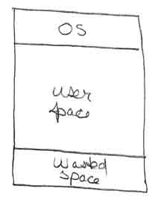
Single Contiguous Allocation Scheme (Single User = Single task)
Simplest scheme
Gives the OS the upper OR lower part of memory
Gives to the “job/Task” the remainder – usually only a fraction
Allocation Policy: Allocate all free memory to the “job”
Deallocation: Return memory to free pool when “job” completes – wait for next job.
Advantages: Simple
Disadvantages:
memory not fully utilized
CPU dedicated - not fully utilized – suffers I/O waits.
DOS, we can do better →
Notes:
The most important system program is the OS.
The OS masks the details of the hardware from the programmer and provides the
programmer with a convenient interface for using the system. It acts as mediator,
making it easier for the programmer and for application programs to access and use
those facilities and services.
Briefly, the OS typically provides services in the following areas:
• Program creation: The OS provides a variety of facilities and services, such
as editors and debuggers, to assist the programmer in creating programs.
Typically, these services are in the form of utility programs that are not actually
part of the OS but are accessible through the OS.
• Program execution: A number of steps need to be performed to execute a
program. Instructions and data must be loaded into main memory, I/O devices
and files must be initialized, and other resources must be prepared. The OS
handles all of this for the user.
• Access to I/O devices: Each I/O device requires its own specific set of instructions
or control signals for operation. The OS takes care of the details so that
the programmer can think in terms of simple reads and writes.
• Controlled access to files: In the case of files, control must include an understanding
of not only the nature of the I/O device (disk drive, tape drive) but
also the file format on the storage medium. Again, the OS worries about the
details. Further, in the case of a system with multiple simultaneous users, the
OS can provide protection mechanisms to control access to the files.
• System access: In the case of a shared or public system, the OS controls access
to the system as a whole and to specific system resources. The access function
must provide protection of resources and data from unauthorized users and
must resolve conflicts for resource contention.
• Error detection and response: A variety of errors can occur while a computer
system is running. These include internal and external hardware errors, such as
a memory error, or a device failure or malfunction; and various software errors,
such as arithmetic overflow, attempt to access forbidden memory location, and
inability of the OS to grant the request of an application. In each case, the OS must
make the response that clears the error condition with the least impact on running
applications. The response may range from ending the program that caused the
error, to retrying the operation, to simply reporting the error to the application.
• Accounting: A good OS collects usage statistics for various resources and
monitor performance parameters such as response time. On any system, this
information is useful in anticipating the need for future enhancements and in
tuning the system to improve performance. On a multiuser system, the information
can be used for billing purposes.

Slide 7
Uniprogramming
Main Memory divided in two parts
OS/Resident Monitor
User: Where the program will be executed
Multiprogramming
The user part of MM is divided into multiple parts to accommodate multiple tasks/jobs/processes.
The division of MM is done dynamically by the OS, and it is known as Memory Management
Effective Memory Management is critical. Few processes in memory may imply long I/O waits which would lead to a CPU that will be idle most of the time.

Slide 8
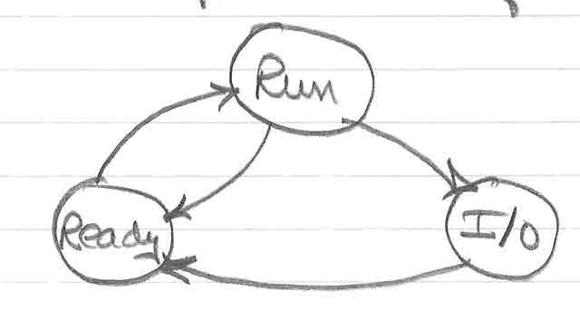
MULTITASKING (Review)
Multitasking/Multiprogramming (MP) is the interleaving and concurrent execution of two or more jobs/tasks at the same time.
Recognizes that I/O is slow – I/O wastes CPU time waiting for I/O completion in single job environment.
MP switches the CPU between jobs when one initiates I/O. The idea with MP is to keep the CPU busy
MP may be illustrated using a job state diagram.
Notes:
The most important system program is the OS.
The OS masks the details of the hardware from the programmer and provides the
programmer with a convenient interface for using the system. It acts as mediator,
making it easier for the programmer and for application programs to access and use
those facilities and services.
Briefly, the OS typically provides services in the following areas:
• Program creation: The OS provides a variety of facilities and services, such
as editors and debuggers, to assist the programmer in creating programs.
Typically, these services are in the form of utility programs that are not actually
part of the OS but are accessible through the OS.
• Program execution: A number of steps need to be performed to execute a
program. Instructions and data must be loaded into main memory, I/O devices
and files must be initialized, and other resources must be prepared. The OS
handles all of this for the user.
• Access to I/O devices: Each I/O device requires its own specific set of instructions
or control signals for operation. The OS takes care of the details so that
the programmer can think in terms of simple reads and writes.
• Controlled access to files: In the case of files, control must include an understanding
of not only the nature of the I/O device (disk drive, tape drive) but
also the file format on the storage medium. Again, the OS worries about the
details. Further, in the case of a system with multiple simultaneous users, the
OS can provide protection mechanisms to control access to the files.
• System access: In the case of a shared or public system, the OS controls access
to the system as a whole and to specific system resources. The access function
must provide protection of resources and data from unauthorized users and
must resolve conflicts for resource contention.
• Error detection and response: A variety of errors can occur while a computer
system is running. These include internal and external hardware errors, such as
a memory error, or a device failure or malfunction; and various software errors,
such as arithmetic overflow, attempt to access forbidden memory location, and
inability of the OS to grant the request of an application. In each case, the OS must
make the response that clears the error condition with the least impact on running
applications. The response may range from ending the program that caused the
error, to retrying the operation, to simply reporting the error to the application.
• Accounting: A good OS collects usage statistics for various resources and
monitor performance parameters such as response time. On any system, this
information is useful in anticipating the need for future enhancements and in
tuning the system to improve performance. On a multiuser system, the information
can be used for billing purposes.

Slide 9
MULTITASKING (Review)
Consider an example of a multiprogramming situation.
Scenario: 3 jobs in RAM
Job1 starts & computes (C1) until I/O requested (I1)
Job2 starts & computes (C2) until I/O requested (I2)
Job3 starts & computes (C3) until I/O requested (I3)
Ci = Computing Time for Job i
Ii = Interruption Time for Job i
Notes:
The most important system program is the OS.
The OS masks the details of the hardware from the programmer and provides the
programmer with a convenient interface for using the system. It acts as mediator,
making it easier for the programmer and for application programs to access and use
those facilities and services.
Briefly, the OS typically provides services in the following areas:
• Program creation: The OS provides a variety of facilities and services, such
as editors and debuggers, to assist the programmer in creating programs.
Typically, these services are in the form of utility programs that are not actually
part of the OS but are accessible through the OS.
• Program execution: A number of steps need to be performed to execute a
program. Instructions and data must be loaded into main memory, I/O devices
and files must be initialized, and other resources must be prepared. The OS
handles all of this for the user.
• Access to I/O devices: Each I/O device requires its own specific set of instructions
or control signals for operation. The OS takes care of the details so that
the programmer can think in terms of simple reads and writes.
• Controlled access to files: In the case of files, control must include an understanding
of not only the nature of the I/O device (disk drive, tape drive) but
also the file format on the storage medium. Again, the OS worries about the
details. Further, in the case of a system with multiple simultaneous users, the
OS can provide protection mechanisms to control access to the files.
• System access: In the case of a shared or public system, the OS controls access
to the system as a whole and to specific system resources. The access function
must provide protection of resources and data from unauthorized users and
must resolve conflicts for resource contention.
• Error detection and response: A variety of errors can occur while a computer
system is running. These include internal and external hardware errors, such as
a memory error, or a device failure or malfunction; and various software errors,
such as arithmetic overflow, attempt to access forbidden memory location, and
inability of the OS to grant the request of an application. In each case, the OS must
make the response that clears the error condition with the least impact on running
applications. The response may range from ending the program that caused the
error, to retrying the operation, to simply reporting the error to the application.
• Accounting: A good OS collects usage statistics for various resources and
monitor performance parameters such as response time. On any system, this
information is useful in anticipating the need for future enhancements and in
tuning the system to improve performance. On a multiuser system, the information
can be used for billing purposes.

Slide 10
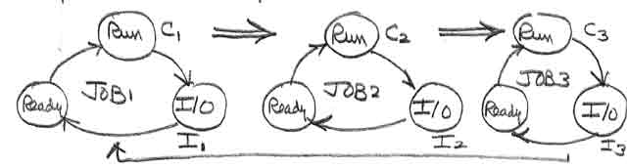
MULTITASKING (Review)
When Job3 starts I/O – CPU is reassigned to Job1 – provided I1 is completed.
Significance
CPU utilization is much higher with MP(Multi Programming)
if I1 <= C2 + C3 – then the CPU is NOT idle
if I1 > C2 + C3 – then CPU IS idle for [I1 – (C2+C3)]
Hence the CPU is idle only if all jobs are in I/O waits – hence CPU utilization is much higher with MP. All modern OS are multiprogramming/multitasking OS.
Notes:
The most important system program is the OS.
The OS masks the details of the hardware from the programmer and provides the
programmer with a convenient interface for using the system. It acts as mediator,
making it easier for the programmer and for application programs to access and use
those facilities and services.
Briefly, the OS typically provides services in the following areas:
• Program creation: The OS provides a variety of facilities and services, such
as editors and debuggers, to assist the programmer in creating programs.
Typically, these services are in the form of utility programs that are not actually
part of the OS but are accessible through the OS.
• Program execution: A number of steps need to be performed to execute a
program. Instructions and data must be loaded into main memory, I/O devices
and files must be initialized, and other resources must be prepared. The OS
handles all of this for the user.
• Access to I/O devices: Each I/O device requires its own specific set of instructions
or control signals for operation. The OS takes care of the details so that
the programmer can think in terms of simple reads and writes.
• Controlled access to files: In the case of files, control must include an understanding
of not only the nature of the I/O device (disk drive, tape drive) but
also the file format on the storage medium. Again, the OS worries about the
details. Further, in the case of a system with multiple simultaneous users, the
OS can provide protection mechanisms to control access to the files.
• System access: In the case of a shared or public system, the OS controls access
to the system as a whole and to specific system resources. The access function
must provide protection of resources and data from unauthorized users and
must resolve conflicts for resource contention.
• Error detection and response: A variety of errors can occur while a computer
system is running. These include internal and external hardware errors, such as
a memory error, or a device failure or malfunction; and various software errors,
such as arithmetic overflow, attempt to access forbidden memory location, and
inability of the OS to grant the request of an application. In each case, the OS must
make the response that clears the error condition with the least impact on running
applications. The response may range from ending the program that caused the
error, to retrying the operation, to simply reporting the error to the application.
• Accounting: A good OS collects usage statistics for various resources and
monitor performance parameters such as response time. On any system, this
information is useful in anticipating the need for future enhancements and in
tuning the system to improve performance. On a multiuser system, the information
can be used for billing purposes.

Slide 11
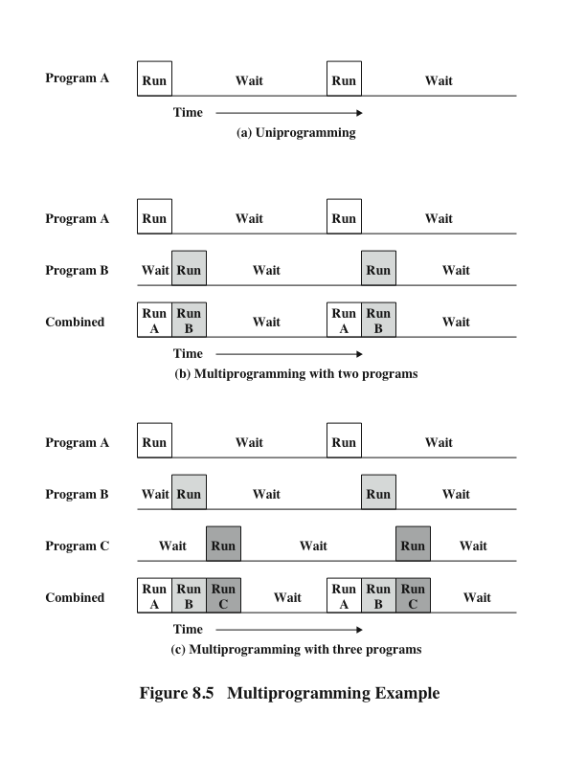
Multiprogramming Example (Review)
Notes:
The processor spends a certain amount of time executing, until it reaches an I/O instruction. It must then wait until that I/O
instruction concludes before proceeding.
This inefficiency is not necessary. We know that there must be enough memory
to hold the OS (resident monitor) and one user program. Suppose that there
is room for the OS and two user programs. Now, when one job needs to wait for
I/O, the processor can switch to the other job, which likely is not waiting for I/O
(Figure 8.5b). Furthermore, we might expand memory to hold three, four, or more
programs and switch among all of them (Figure 8.5c). This technique is known as multiprogramming,
or multitasking. It is the central theme of modern operating systems.
As with a simple batch system, a multiprogramming batch system must rely
on certain computer hardware features. The most notable additional feature that
is useful for multiprogramming is the hardware that supports I/O interrupts and
DMA. With interrupt-driven I/O or DMA, the processor can issue an I/O command
for one job and proceed with the execution of another job while the I/O is carried
out by the device controller. When the I/O operation is complete, the processor is
interrupted and control is passed to an interrupt-handling program in the OS. The
OS will then pass control to another job.

Slide 12
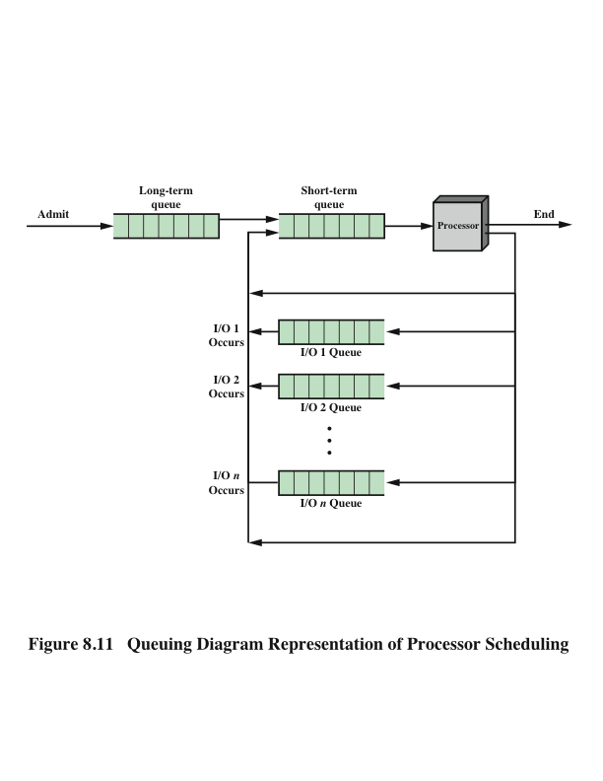
Process Scheduling
Long term Queue:
A list of jobs waiting to use the system (typically in disk)
Short Term Queue:
All processes in the READY state
I/O Queue:
One per each I/O device
Notes:
Figure 8.11 suggests how processes progress through the computer under the
control of the OS. Each process request (batch job, user-defined interactive job) is
placed in the long-term queue. As resources become available, a process request
becomes a process and is then placed in the ready state and put in the short-term
queue. The processor alternates between executing OS instructions and executing
user processes. While the OS is in control, it decides which process in the short-term
queue should be executed next. When the OS has finished its immediate tasks, it
turns the processor over to the chosen process.
As was mentioned earlier, a process being executed may be suspended for
a variety of reasons. If it is suspended because the process requests I/O, then it
is placed in the appropriate I/O queue. If it is suspended because of a timeout or
because the OS must attend to pressing business, then it is placed in the ready state
and put into the short-term queue.
Finally, we mention that the OS also manages the I/O queues. When an I/O
operation is completed, the OS removes the satisfied process from that I/O queue
and places it in the short-term queue. It then selects another waiting process (if any)
and signals for the I/O device to satisfy that process’s request.

Slide 13
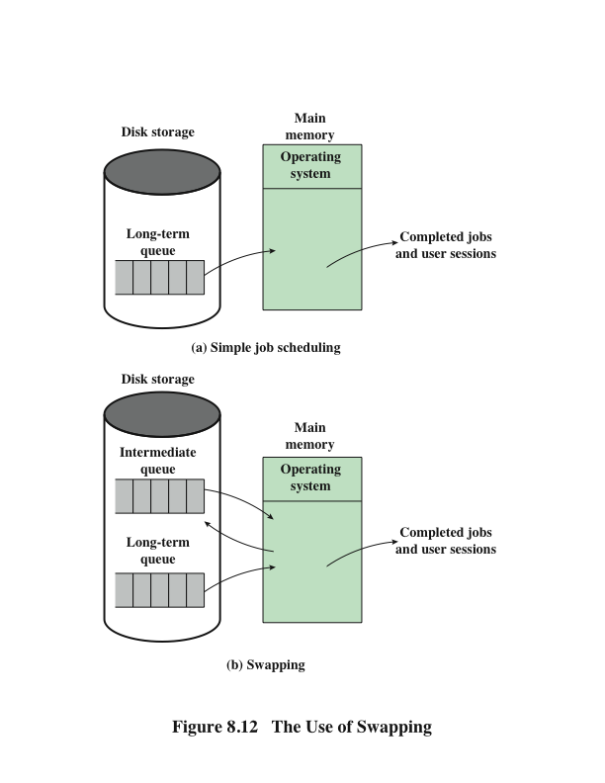
Memory Management
Swapping
Notes:
Main memory could be expanded, and so be able to accommodate
more processes. But there are two flaws in this approach. First, main memory
is expensive, even today. Second, the appetite of programs for memory has grown
as fast as the cost of memory has dropped. So larger memory results in larger processes,
not more processes.
Another solution is swapping, depicted in Figure 8.12. We have a long-term
queue of process requests, typically stored on disk. These are brought in, one at a
time, as space becomes available. As processes are completed, they are moved out
of main memory. Now the situation will arise that none of the processes in memory
are in the ready state (e.g., all are waiting on an I/O operation). Rather than remain
idle, the processor swaps one of these processes back out to disk into an intermediate
queue. This is a queue of existing processes that have been temporarily kicked out
of memory. The OS then brings in another process from the intermediate queue, or
it honors a new process request from the long-term queue. Execution then continues
with the newly arrived process.
Swapping, however, is an I/O operation, and therefore there is the potential
for making the problem worse, not better. But because disk I/O is generally the
fastest I/O on a system (e.g., compared with tape or printer I/O), swapping will usually
enhance performance. A more sophisticated scheme, involving virtual memory,
improves performance over simple swapping. This will be discussed shortly. But
first, we must prepare the ground by explaining partitioning and paging.

Slide 14
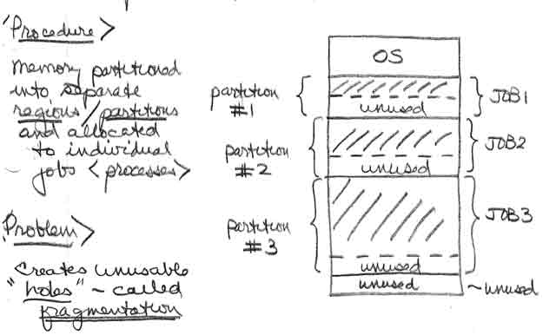
MULTITASKING
Partitioned Allocation Scheme
Wasted CPU time is solved by MP.
To support MP we need a new memory management schemes.
Two variations of partitioned allocation were used:
Static Partition Allocation – used fixed sized partitions defined at SYSGEN time
Dynamic Partition Allocation – attempted to dynamically match job size to partition size by tracking allocated and free areas – and attempting to match a job size with available free areas.
<Problem> Fragmentation – unused small areas of free memory occur.
Notes:
The most important system program is the OS.
The OS masks the details of the hardware from the programmer and provides the
programmer with a convenient interface for using the system. It acts as mediator,
making it easier for the programmer and for application programs to access and use
those facilities and services.
Briefly, the OS typically provides services in the following areas:
• Program creation: The OS provides a variety of facilities and services, such
as editors and debuggers, to assist the programmer in creating programs.
Typically, these services are in the form of utility programs that are not actually
part of the OS but are accessible through the OS.
• Program execution: A number of steps need to be performed to execute a
program. Instructions and data must be loaded into main memory, I/O devices
and files must be initialized, and other resources must be prepared. The OS
handles all of this for the user.
• Access to I/O devices: Each I/O device requires its own specific set of instructions
or control signals for operation. The OS takes care of the details so that
the programmer can think in terms of simple reads and writes.
• Controlled access to files: In the case of files, control must include an understanding
of not only the nature of the I/O device (disk drive, tape drive) but
also the file format on the storage medium. Again, the OS worries about the
details. Further, in the case of a system with multiple simultaneous users, the
OS can provide protection mechanisms to control access to the files.
• System access: In the case of a shared or public system, the OS controls access
to the system as a whole and to specific system resources. The access function
must provide protection of resources and data from unauthorized users and
must resolve conflicts for resource contention.
• Error detection and response: A variety of errors can occur while a computer
system is running. These include internal and external hardware errors, such as
a memory error, or a device failure or malfunction; and various software errors,
such as arithmetic overflow, attempt to access forbidden memory location, and
inability of the OS to grant the request of an application. In each case, the OS must
make the response that clears the error condition with the least impact on running
applications. The response may range from ending the program that caused the
error, to retrying the operation, to simply reporting the error to the application.
• Accounting: A good OS collects usage statistics for various resources and
monitor performance parameters such as response time. On any system, this
information is useful in anticipating the need for future enhancements and in
tuning the system to improve performance. On a multiuser system, the information
can be used for billing purposes.

Slide 15
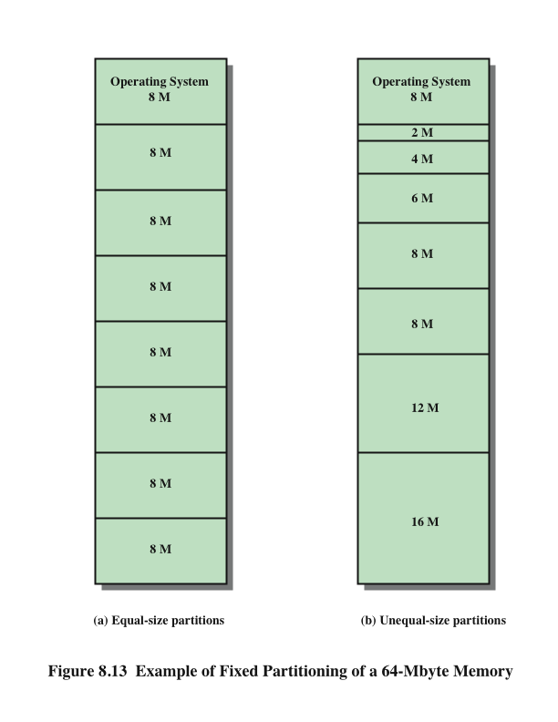
Memory Management
Partitioning
Equal Size
Unequal Size
Variable Size (Dynamic)
Solved with Compaction
Notes:
The simplest scheme for partitioning available memory is to use fixed-size partitions,
as shown in Figure 8.13. Note that, although the partitions are of fixed size,
they need not be of equal size. When a process is brought into memory, it is placed
in the smallest available partition that will hold it.
Even with the use of unequal fixed-size partitions, there will be wasted memory.
In most cases, a process will not require exactly as much memory as provided by the
partition. For example, a process that requires 3M bytes of memory would be placed
in the 4M partition of Figure 8.13b, wasting 1M that could be used by another process.
A more efficient approach is to use variable-size partitions. When a process is
brought into memory, it is allocated exactly as much memory as it requires and no more.

Slide 16
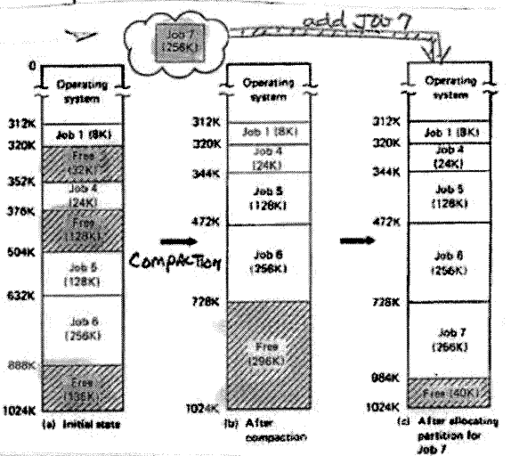
Relocatable Partition Allocation (Compaction)
Problem:
All location sensitive addresses must be modified in the compaction Process → code must be relocatable code
Solution:
Use SW addresses adjustments (not efficient)
Use HW relocation registers (most common solution, also known as base relocation register)
Notes:
Before we consider ways of dealing with the shortcomings of partitioning, we
must clear up one loose end. Consider Figure 8.14; it should be obvious that a process
is not likely to be loaded into the same place in main memory each time it is
swapped in. Furthermore, if compaction is used, a process may be shifted while in
main memory. A process in memory consists of instructions plus data. The instructions
will contain addresses for memory locations of two types:
• Addresses of data items
• Addresses of instructions, used for branching instructions
But these addresses are not fixed. They will change each time a process is
swapped in. To solve this problem, a distinction is made between logical addresses
and physical addresses. A logical address is expressed as a location relative to the
beginning of the program. Instructions in the program contain only logical addresses.
A physical address is an actual location in main memory. When the processor executes
a process, it automatically converts from logical to physical address by adding
the current starting location of the process, called its base address, to each logical
address. This is another example of a processor hardware feature designed to meet
an OS requirement. The exact nature of this hardware feature depends on the memory
management strategy in use. We will see several examples later in this chapter.

Slide 17
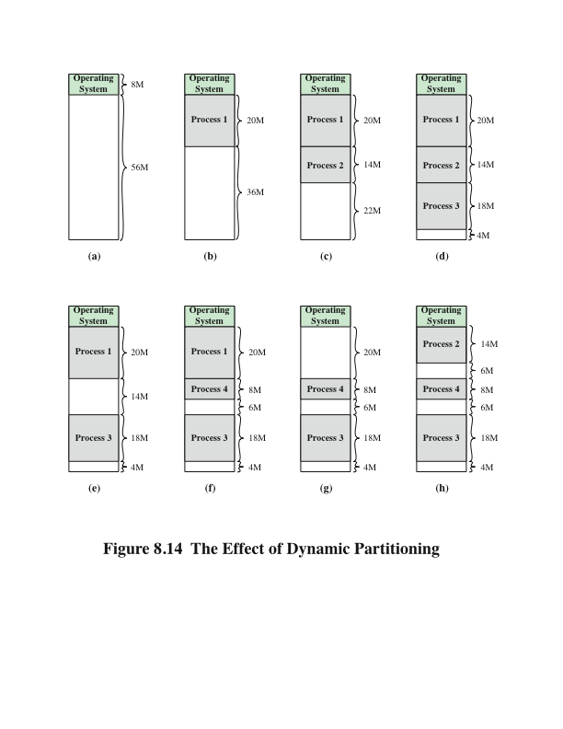
Effect of Dynamic Partitioning
Let’s analyze the images, but keep track of Process 2.
Logical address
- expressed as a location relative to the
beginning of the program
Physical address
- an actual location in main memory
Base address
- current starting location of the process
Logical + Base = Physical
Notes:
Before we consider ways of dealing with the shortcomings of partitioning, we
must clear up one loose end. Consider Figure 8.14; it should be obvious that a process
is not likely to be loaded into the same place in main memory each time it is
swapped in. Furthermore, if compaction is used, a process may be shifted while in
main memory. A process in memory consists of instructions plus data. The instructions
will contain addresses for memory locations of two types:
• Addresses of data items
• Addresses of instructions, used for branching instructions
But these addresses are not fixed. They will change each time a process is
swapped in. To solve this problem, a distinction is made between logical addresses
and physical addresses. A logical address is expressed as a location relative to the
beginning of the program. Instructions in the program contain only logical addresses.
A physical address is an actual location in main memory. When the processor executes
a process, it automatically converts from logical to physical address by adding
the current starting location of the process, called its base address, to each logical
address. This is another example of a processor hardware feature designed to meet
an OS requirement. The exact nature of this hardware feature depends on the memory
management strategy in use. We will see several examples later in this chapter.

Slide 18
Memory Management
Paging
Before : Unequal size and Variable size partitions → inefficient
NOW:
Memory (divided into) → FRAMES (Page Frames)
Process (divided into) → Pages
Notes:
Both unequal fixed-size and variable-size partitions are inefficient in the use of
memory. Suppose, however, that memory is partitioned into equal fixed-size chunks
that are relatively small, and that each process is also divided into small fixed-size
chunks of some size. Then the chunks of a program, known as pages, could be
assigned to available chunks of memory, known as frames, or page frames. At most,
then, the wasted space in memory for that process is a fraction of the last page.
Figure 8.15 shows an example of the use of pages and frames. At a given point
in time, some of the frames in memory are in use and some are free. The list of free
frames is maintained by the OS. Process A, stored on disk, consists of four pages.
When it comes time to load this process, the OS finds four free frames and loads the
four pages of the process A into the four frames.

Slide 19
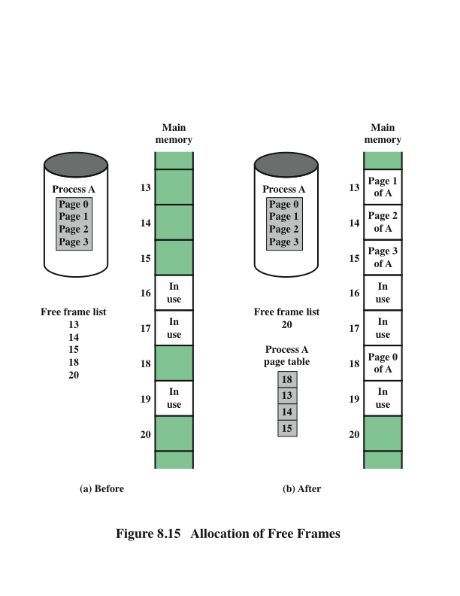
Memory Management
Paging
Frame = Page Frame
Maintained by the OS
Maintained by the OS
* 1 Per Process
Notes:
Both unequal fixed-size and variable-size partitions are inefficient in the use of
memory. Suppose, however, that memory is partitioned into equal fixed-size chunks
that are relatively small, and that each process is also divided into small fixed-size
chunks of some size. Then the chunks of a program, known as pages, could be
assigned to available chunks of memory, known as frames, or page frames. At most,
then, the wasted space in memory for that process is a fraction of the last page.
Figure 8.15 shows an example of the use of pages and frames. At a given point
in time, some of the frames in memory are in use and some are free. The list of free
frames is maintained by the OS. Process A, stored on disk, consists of four pages.
When it comes time to load this process, the OS finds four free frames and loads the
four pages of the process A into the four frames.

Slide 20
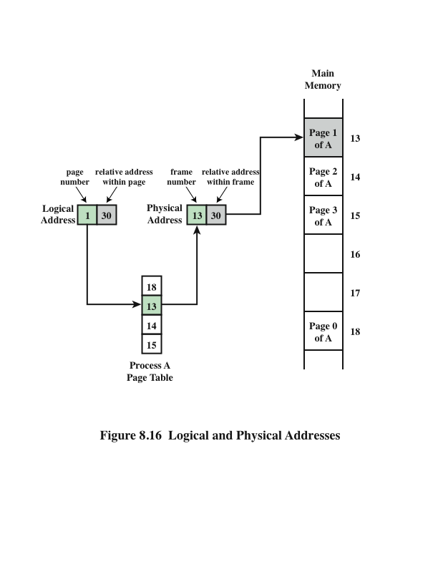
Logical and Physical Addresses Paging
Maintained by the OS
* 1 Per Process
Notes:
Now suppose, as in this example, that there are not sufficient unused contiguous
frames to hold the process. Does this prevent the OS from loading A?
The answer is no, because we can once again use the concept of logical address. A
simple base address will no longer suffice. Rather, the OS maintains a page table
for each process. The page table shows the frame location for each page of the
process. Within the program, each logical address consists of a page number and
a relative address within the page. Recall that in the case of simple partitioning, a
logical address is the location of a word relative to the beginning of the program;
the processor translates that into a physical address. With paging, the logical-to-
physical address translation is still done by processor hardware. The processor
must know how to access the page table of the current process. Presented with a
logical address (page number, relative address), the processor uses the page table
to produce a physical address (frame number, relative address). An example is
shown in Figure 8.16.
This approach solves the problems raised earlier. Main memory is divided
into many small equal-size frames. Each process is divided into frame-size pages:
smaller processes require fewer pages, larger processes require more. When a
process is brought in, its pages are loaded into available frames, and a page table
is set up.

Slide 21
Virtual Memory
Demand Paging
Each page of a process is brought in only when it is needed
Principle of locality
When working with a large process execution may be confined to a small section of a program (subroutine)
It is better use of memory to load in just a few pages
If the program references data or branches to an instruction on a page not in main memory, a page fault is triggered which tells the OS to bring in the desired page
Advantages:
More processes can be maintained in memory
Time is saved because unused pages are not swapped in and out of memory
Disadvantages:
When one page is brought in, another page must be thrown out (page replacement)
If a page is thrown out just before it is about to be used the OS will have to go get the page again
Thrashing
When the processor spends most of its time swapping pages rather than executing instructions
Notes:
With the use of paging, truly effective multiprogramming
systems came into being. Furthermore, the simple tactic of breaking a process up
into pages led to the development of another important concept: virtual memory.
To understand virtual memory, we must add a refinement to the paging
scheme just discussed. That refinement is demand paging, which simply means that
each page of a process is brought in only when it is needed, that is, on demand.
Consider a large process, consisting of a long program plus a number of arrays
of data. Over any short period of time, execution may be confined to a small section
of the program (e.g., a subroutine), and perhaps only one or two arrays of data
are being used. This is the principle of locality, which we introduced in Appendix
4A. It would clearly be wasteful to load in dozens of pages for that process when
only a few pages will be used before the program is suspended. We can make better
use of memory by loading in just a few pages. Then, if the program branches
to an instruction on a page not in main memory, or if the program references data
on a page not in memory, a page fault is triggered. This tells the OS to bring in the
desired page.
Thus, at any one time, only a few pages of any given process are in memory,
and therefore more processes can be maintained in memory. Furthermore, time is
saved because unused pages are not swapped in and out of memory. However, the
OS must be clever about how it manages this scheme. When it brings one page in, it
must throw another page out; this is known as page replacement. If it throws out a
page just before it is about to be used, then it will just have to go get that page again
almost immediately. Too much of this leads to a condition known as thrashing: the
processor spends most of its time swapping pages rather than executing instructions.
The avoidance of thrashing was a major research area in the 1970s and led to a variety
of complex but effective algorithms. In essence, the OS tries to guess, based on
recent history, which pages are least likely to be used in the near future.
With demand paging, it is not necessary to load an entire process into main
memory. This fact has a remarkable consequence: It is possible for a process to be
larger than all of main memory. One of the most fundamental restrictions in programming
has been lifted. Without demand paging, a programmer must be acutely
aware of how much memory is available. If the program being written is too large,
the programmer must devise ways to structure the program into pieces that can
be loaded one at a time. With demand paging, that job is left to the OS and the
hardware. As far as the programmer is concerned, he or she is dealing with a huge
memory, the size associated with disk storage.
Because a process executes only in main memory, that memory is referred to
as real memory. But a programmer or user perceives a much larger memory—that
which is allocated on the disk. This latter is therefore referred to as virtual memory.
Virtual memory allows for very effective multiprogramming and relieves the user of
the unnecessarily tight constraints of main memory.

Slide 22
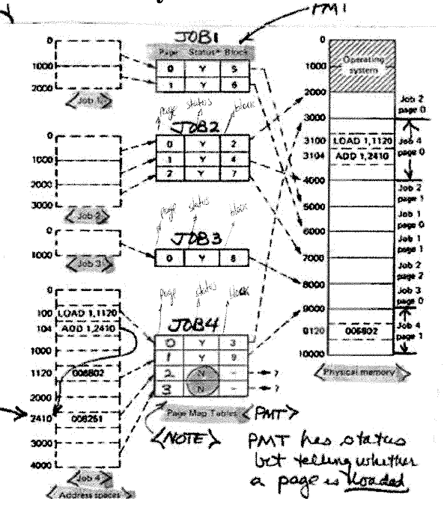
Notes:
The basic mechanism for reading a word from memory
involves the translation of a virtual, or logical, address, consisting of page number
and offset, into a physical address, consisting of frame number and offset, using a
page table. Because the page table is of variable length, depending on the size of the
process, we cannot expect to hold it in registers. Instead, it must be in main memory
to be accessed. Figure 8.16 suggests a hardware implementation of this scheme.
When a particular process is running, a register holds the starting address of the
page table for that process. The page number of a virtual address is used to index
that table and look up the corresponding frame number. This is combined with the
offset portion of the virtual address to produce the desired real address.
In most systems, there is one page table per process. But each process can
occupy huge amounts of virtual memory. For example, in the VAX architecture,
each process can have up to 2³¹ = 2 Gbytes of virtual memory. Using 2⁹ = 512-byte
pages, that means that as many as 2²² page table entries are required per process.
Clearly, the amount of memory devoted to page tables alone could be unacceptably
high. To overcome this problem, most virtual memory schemes store page tables in
virtual memory rather than real memory. This means that page tables are subject to
paging just as other pages are. When a process is running, at least a part of its page
table must be in main memory, including the page table entry of the currently executing
page. Some processors make use of a two-level scheme to organize large page
tables. In this scheme, there is a page directory, in which each entry points to a page
table. Thus, if the length of the page directory is X, and if the maximum length of a
page table is Y, then a process can consist of up to X * Y pages. Typically, the maximum
length of a page table is restricted to be equal to one page. We will see an example
of this two-level approach when we consider the Pentium II later in this chapter.

Slide 23
Operation of Paging and Translation Lookaside Buffer (TLB)
In principle: every virtual reference can cause two physical memory accesses:
One to prefetch the appropriate page table
And one to fetch the desired data.
Special Cache → TLB
Similar to cache memory
Contains those page table entries that have been more recently used.
Notes:
In principle, then, every virtual memory reference can cause two physical memory
accesses: one to fetch the appropriate page table entry, and one to fetch the
desired data. Thus, a straightforward virtual memory scheme would have the effect
of doubling the memory access time. To overcome this problem, most virtual
memory schemes make use of a special cache for page table entries, usually called
a translation lookaside buffer (TLB). This cache functions in the same way as a
memory cache and contains those page table entries that have been most recently
used. Figure 8.18 is a flowchart that shows the use of the TLB. By the principle of
locality, most virtual memory references will be to locations in recently used pages.
Therefore, most references will involve page table entries in the cache. Studies of
the VAX TLB have shown that this scheme can significantly improve performance
[CLAR85, SATY81].

Slide 24
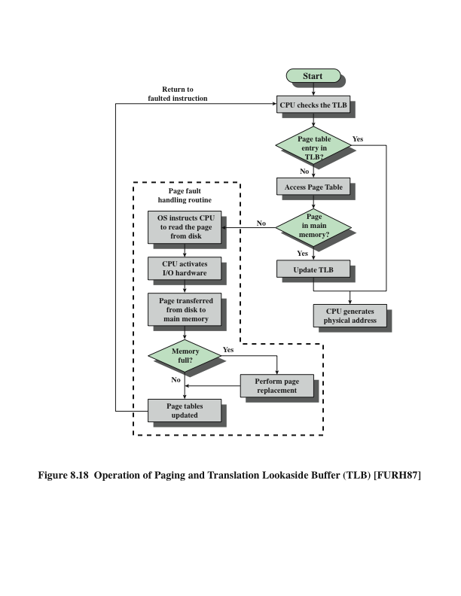
Operation of Paging and Translation Lookaside Buffer (TLB)
Notes:
In principle, then, every virtual memory reference can cause two physical memory
accesses: one to fetch the appropriate page table entry, and one to fetch the
desired data. Thus, a straightforward virtual memory scheme would have the effect
of doubling the memory access time. To overcome this problem, most virtual
memory schemes make use of a special cache for page table entries, usually called
a translation lookaside buffer (TLB). This cache functions in the same way as a
memory cache and contains those page table entries that have been most recently
used. Figure 8.18 is a flowchart that shows the use of the TLB. By the principle of
locality, most virtual memory references will be to locations in recently used pages.
Therefore, most references will involve page table entries in the cache. Studies of
the VAX TLB have shown that this scheme can significantly improve performance
[CLAR85, SATY81].

Slide 25
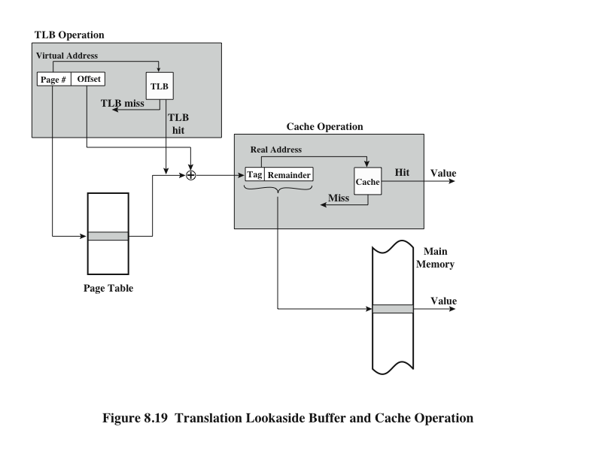
TLB and Cache Operation
Notes:
Note that the virtual memory mechanism must interact with the cache system
(not the TLB cache, but the main memory cache). This is illustrated in Figure 8.19.
A virtual address will generally be in the form of a page number, offset. First, the
memory system consults the TLB to see if the matching page table entry is present.
If it is, the real (physical) address is generated by combining the frame number with
the offset. If not, the entry is accessed from a page table. Once the real address is
generated, which is in the form of a tag and a remainder, the cache is consulted to
see if the block containing that word is present (see Figure 4.5). If so, it is returned
to the processor. If not, the word is retrieved from main memory.
The reader should be able to appreciate the complexity of the processor hardware
involved in a single memory reference. The virtual address is translated into
a real address. This involves reference to a page table, which may be in the TLB, in
main memory, or on disk. The referenced word may be in cache, in main memory,
or on disk. In the latter case, the page containing the word must be loaded into main
memory and its block loaded into the cache. In addition, the page table entry for
that page must be updated.

Slide 26
Memory Management
Paging
Here a simple base address will NOT suffice. Let’s think about it.
Notes:
Both unequal fixed-size and variable-size partitions are inefficient in the use of
memory. Suppose, however, that memory is partitioned into equal fixed-size chunks
that are relatively small, and that each process is also divided into small fixed-size
chunks of some size. Then the chunks of a program, known as pages, could be
assigned to available chunks of memory, known as frames, or page frames. At most,
then, the wasted space in memory for that process is a fraction of the last page.
Figure 8.15 shows an example of the use of pages and frames. At a given point
in time, some of the frames in memory are in use and some are free. The list of free
frames is maintained by the OS. Process A, stored on disk, consists of four pages.
When it comes time to load this process, the OS finds four free frames and loads the
four pages of the process A into the four frames.

Slide 27
Logical and Physical Addresses Paging
Notes:
Now suppose, as in this example, that there are not sufficient unused contiguous
frames to hold the process. Does this prevent the OS from loading A?
The answer is no, because we can once again use the concept of logical address. A
simple base address will no longer suffice. Rather, the OS maintains a page table
for each process. The page table shows the frame location for each page of the
process. Within the program, each logical address consists of a page number and
a relative address within the page. Recall that in the case of simple partitioning, a
logical address is the location of a word relative to the beginning of the program;
the processor translates that into a physical address. With paging, the logical-to-
physical address translation is still done by processor hardware. The processor
must know how to access the page table of the current process. Presented with a
logical address (page number, relative address), the processor uses the page table
to produce a physical address (frame number, relative address). An example is
shown in Figure 8.16.
This approach solves the problems raised earlier. Main memory is divided
into many small equal-size frames. Each process is divided into frame-size pages:
smaller processes require fewer pages, larger processes require more. When a
process is brought in, its pages are loaded into available frames, and a page table
is set up.

